Slide 1
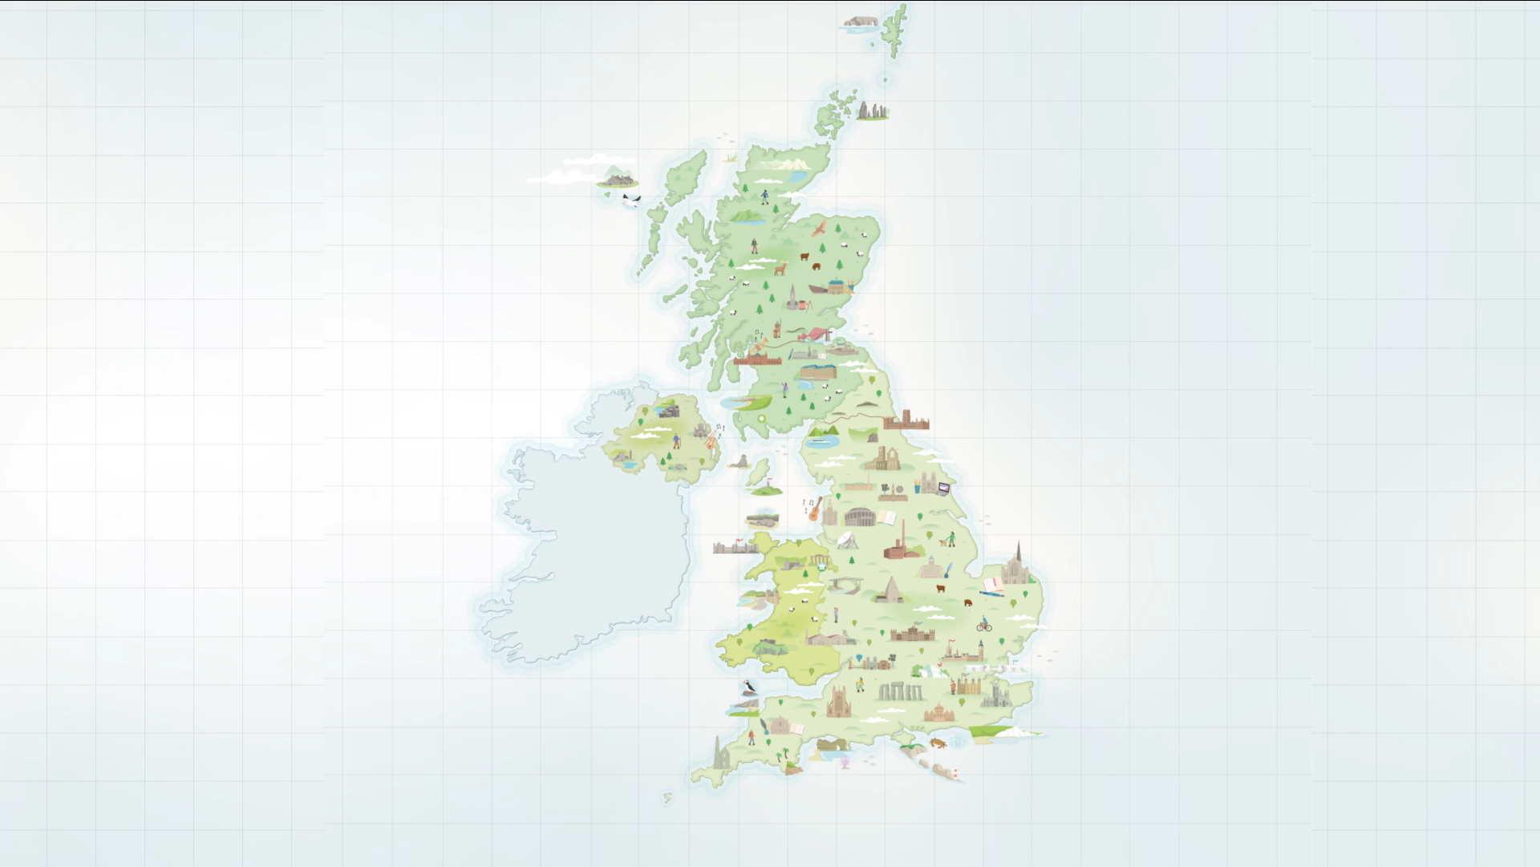
‘Discover the UK’s UNESCO Sites’
Summer campaign 2023
The UK National Commission for UNESCO
Notes:
Local to Global: funded by the National Lottery Heritage Fund
Aim: Build a more resilient network of UNESCO sites in the UK
Process: Foster openness and collaboration amongst all designation types across the four nations of the UK.

Slide 2
Goals:
Deliver an original product and promotional campaign that encourage people to visit and explore the UK UNESCO network
Leverage the power of the network to maximise groundswell and interest in the map across digital channels
Especially promote the map to international audiences including priorities languages of Visit Britain
Encourage deeper understanding of the diversity of UNESCO sites in the UK network
“people’s awareness of UNESCO designations in the UK is generally low and some [designations] are more well-known than others”
- UK National Commission for UNESCO’s National Value of UNESCO to the United Kingdom (2019)

Slide 3
Outputs:
A brand-new illustrated map of UK UNESCO Sites
A fully interactive digital version of the map
Animated short film of the map for digital audiences
25,000 printed hardcopies of the map
Outputs:
7-week network- wide social media campaign
56 posts from UKNC’s own channels
100+ posts from network and partners
Translated versions of the map in 7 languages

Slide 4
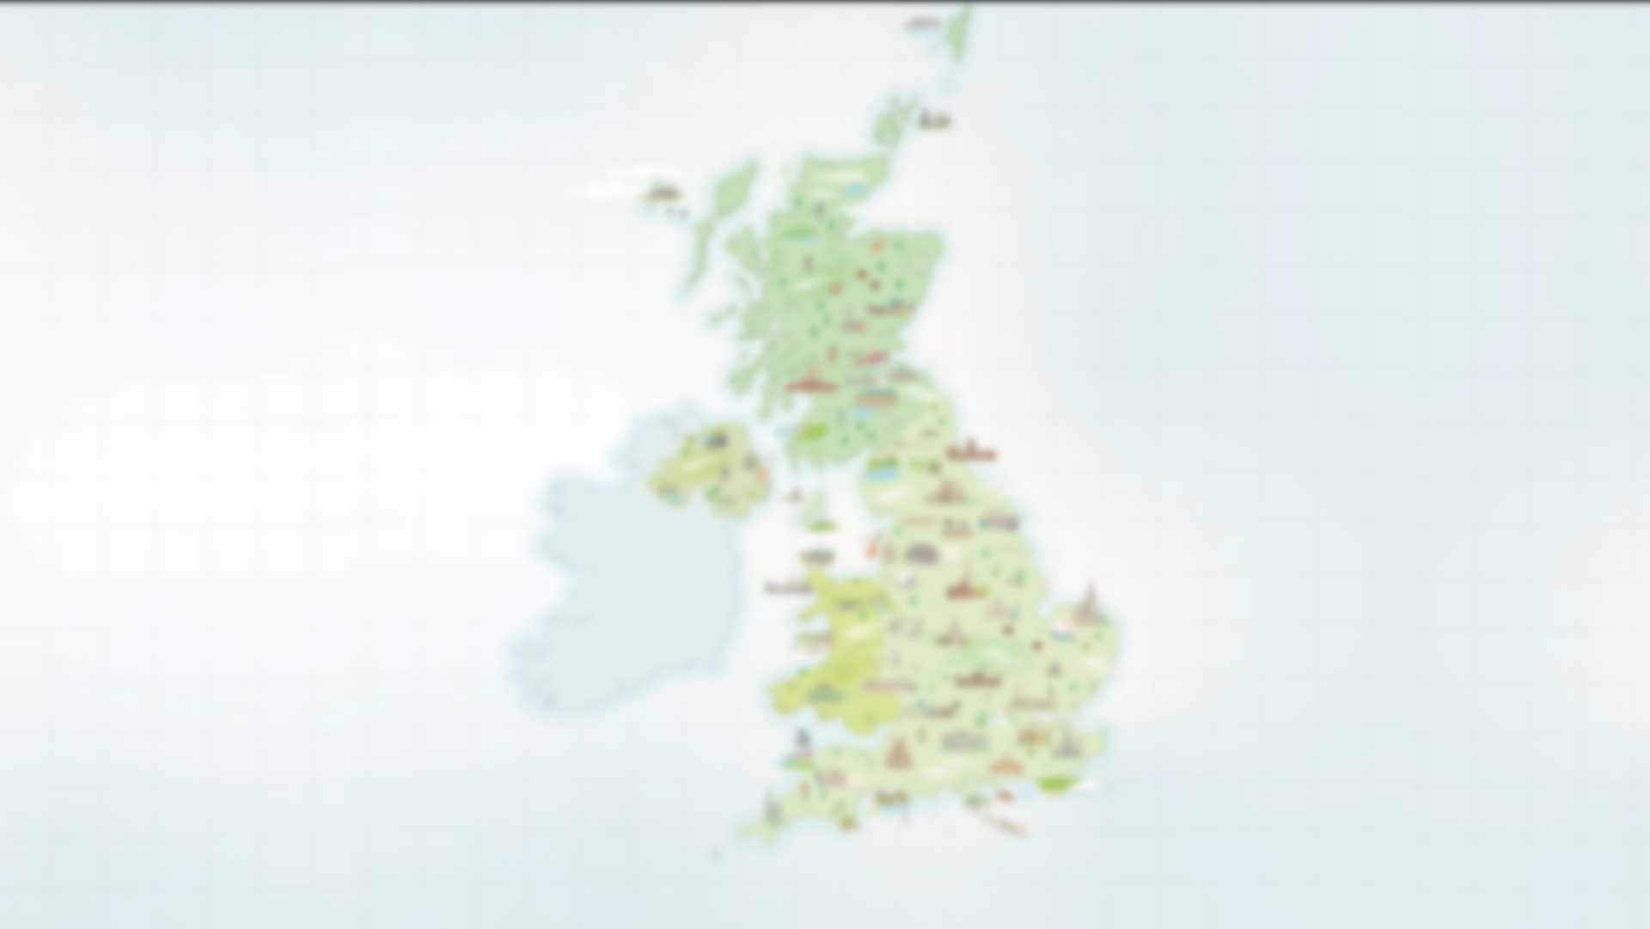
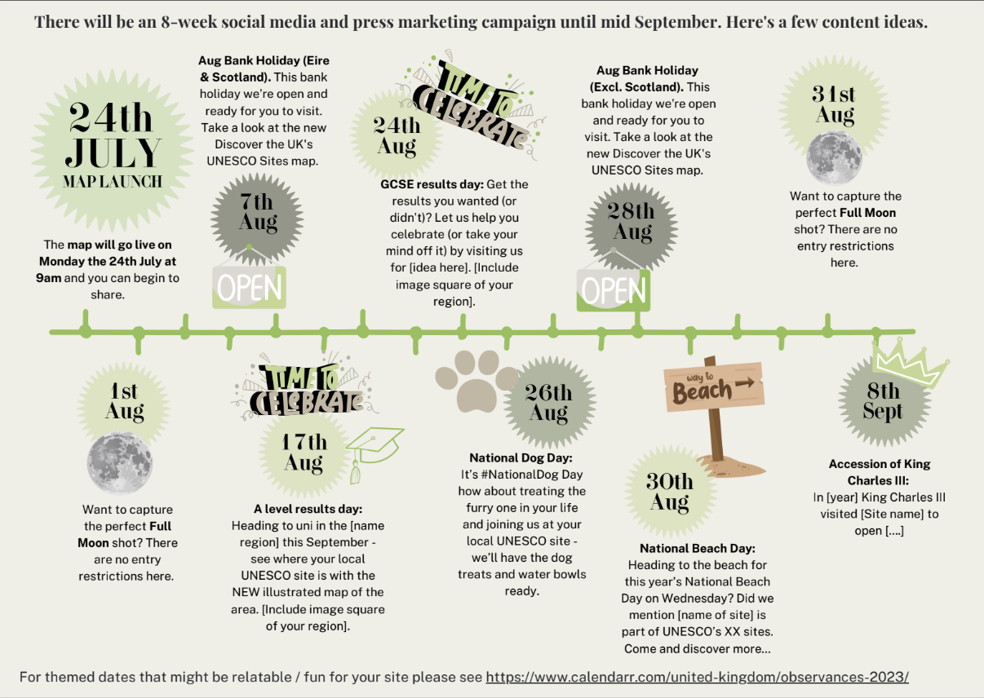
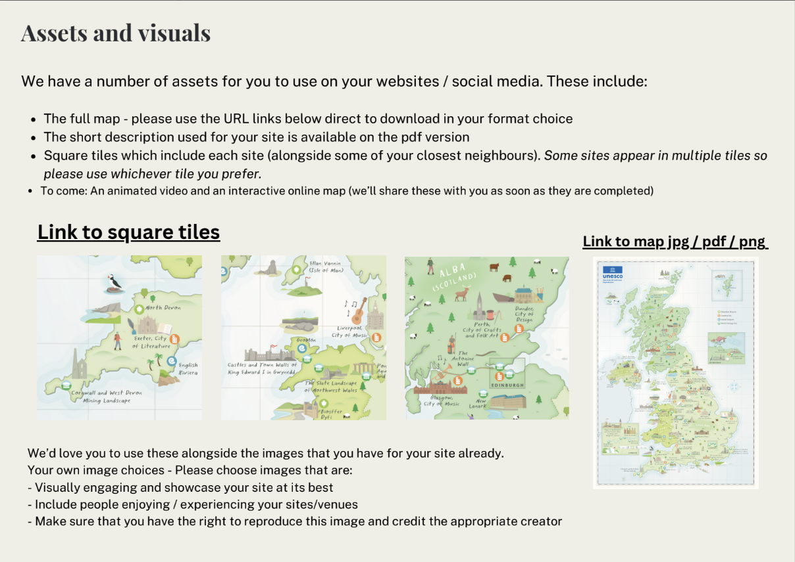

Slide 5
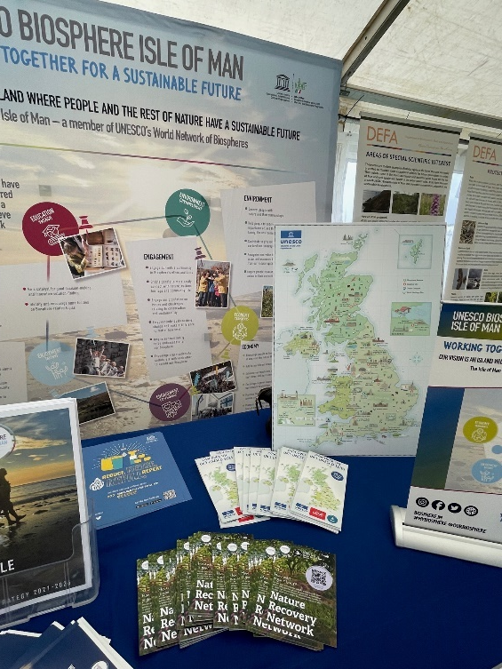

Slide 6
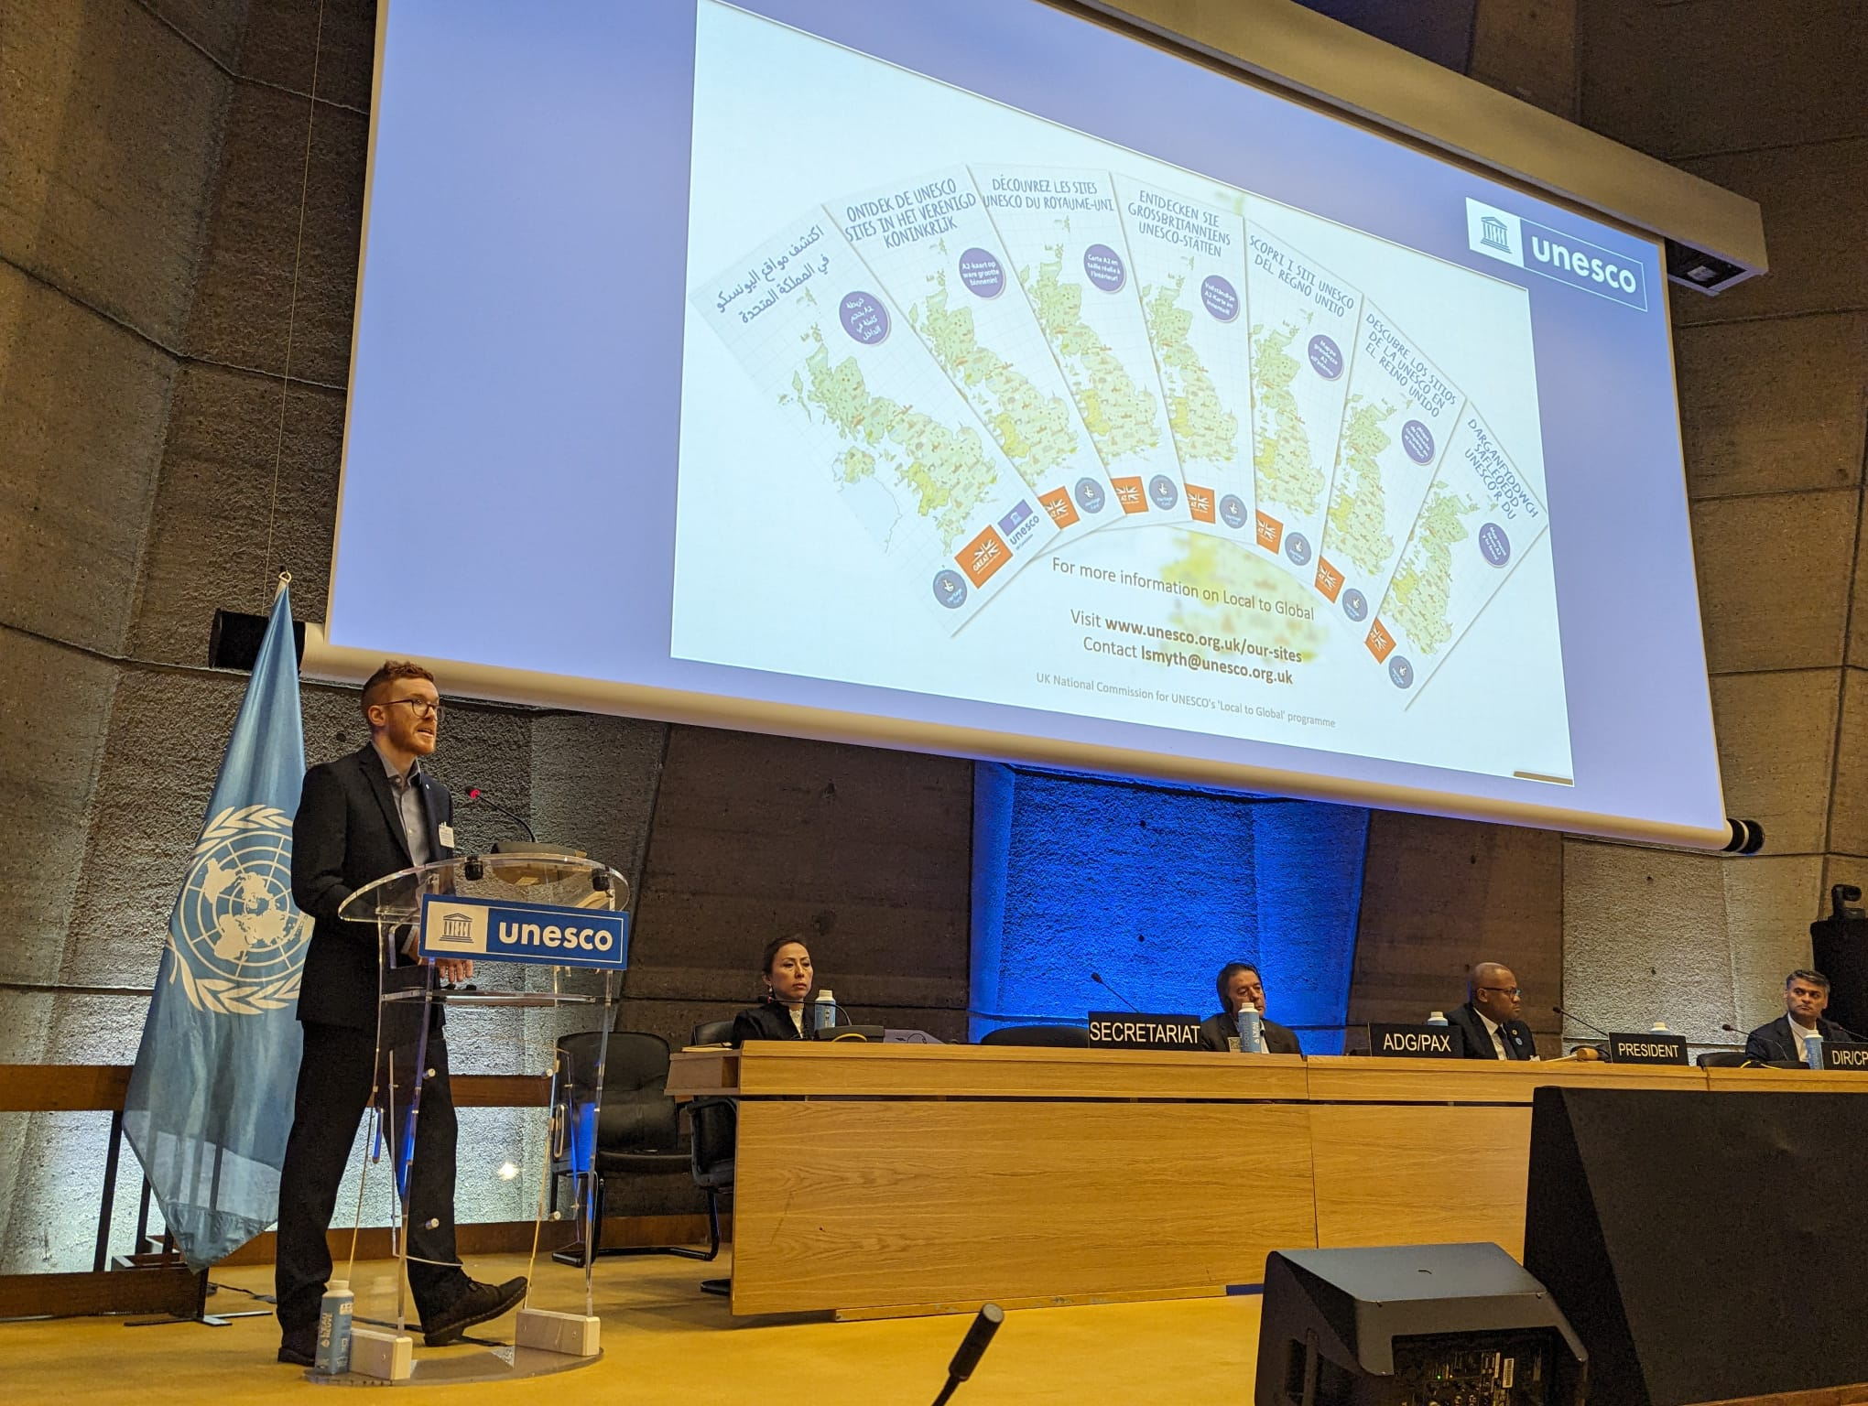
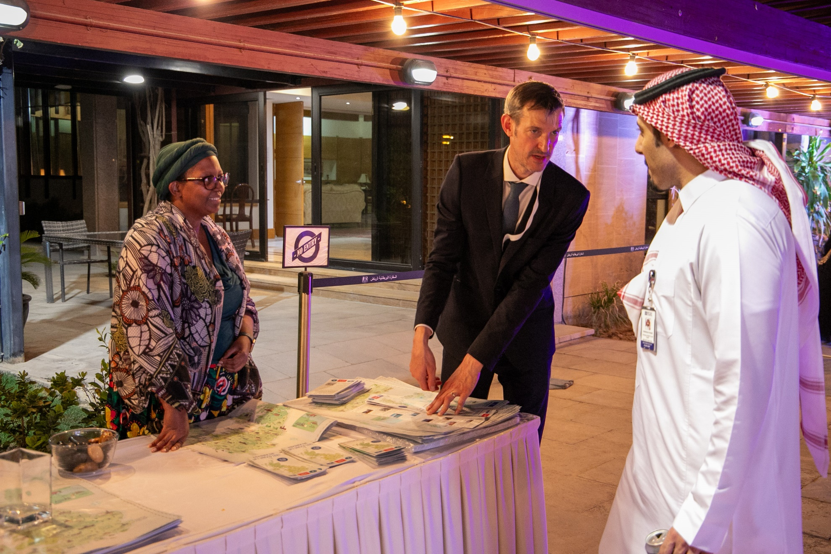

Slide 7
“Discover the UK’s UNESCO Sites” Summer campaign
FROM 24TH JULY 2023 - 8TH SEPTEMBER 2023
There were a total of 56 posts produced across the following platforms:
Short film YouTube views
20,209
+
REACH
TOTAL REACH
REACH = UNIQUE USERS WHO SAW CONTENT
494,624
263,345
197,146
955,115
32,786
IMPRESSIONS
TOTAL IMPRESSIONS
IMPRESSIONS = HOW MANY TIMES CONTENT SHOWED UP ON SOCIAL MEDIA CHANNEL
750,409
342,211
197,146
views on socials
1,289,766
=
ENGAGEMENTS
TOTAL ENGAGEMENTS
ENGAGEMENT = NUMBER OF INTERACTIONS CONTENT HAS RECEIVED FROM USERS (LIKES, COMMENTS, SHARES, SAVES, ETC.)
TOTAL
SHORT FILM VIEWS
3,945
3562
7,156
14,663
1,070% INCREASE VS PREVIOUS MONTH
52,995

Slide 8
Salerno, Italy
Cambridge, UK
Tuscany, Italy
Kent, UK
Hessen, Germany
Vicenza, Italy
Vienna, Austria
Aulrich, Germany

Slide 9
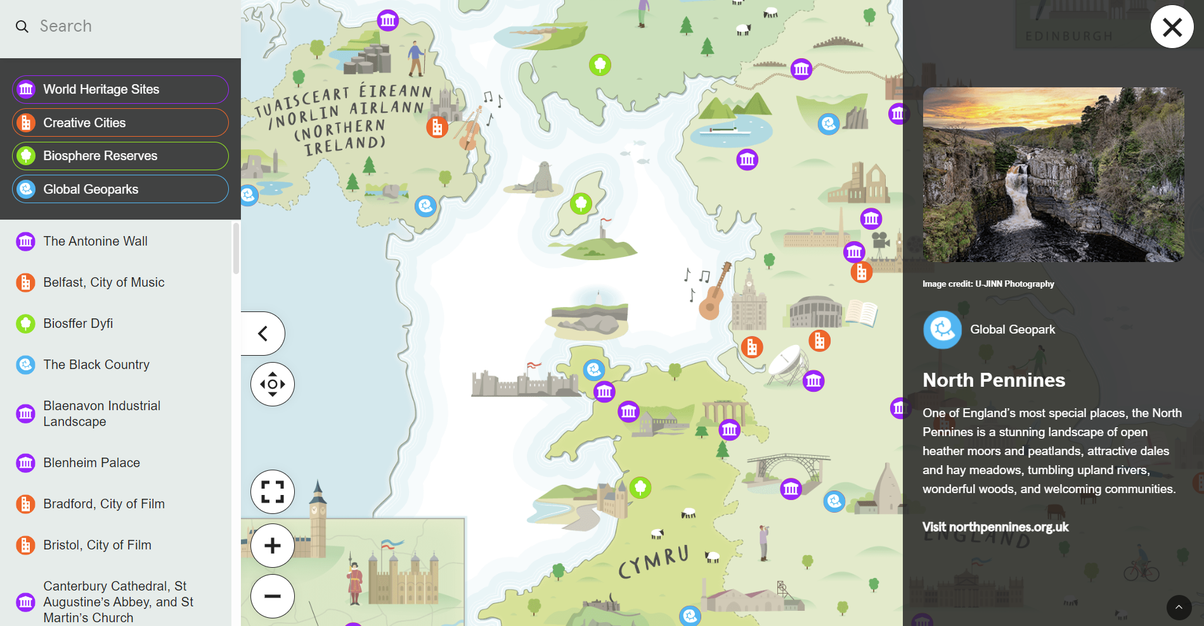

Slide 10
Interactive map
HOW USERS GOT REFERRED
TOTAL VIEWS
32,846
ORGANIC SOCIAL 34.4%
1,411
REFERRAL 30%
UNIQUE
USERS
DIRECT 20.2%
AVG. DAILY VISITORS TO THE WEBSITE FOR THE 4 WEEKS AFTER THE LAUNCH
25,098
ORGANIC SEARCH 5.4%
EMAIL 1.3%
AVG. DAILY VISITORS TO WEBSITE FOR THE 4 WEEKS PRIOR TO LAUNCH
AVERAGE ENGAGEMENT TIME
PAID SEARCH 0.3%
234
600%
INCREASE
00:43
UNASSIGNED 0.2%
LANGUAGE
COUNTRY OF RESIDENCE
UK 61.6%
THE ILLUSTRATED MAPS WERE TRANSLATED INTO 7 LANGUAGES
TAIWAN 5.9%
ENGLISH 72.9%
ITALY 3.8%
CHINESE 6.5%
UNITED STATES 2.9%
ITALIAN 3.7%
SPAIN 2.3%
SPANISH 3.7%
ARGENTINA 1.8%
FRENCH 2.7%
ALGERIA 1.8%
GERMAN 1.1%
FRANCE 1.5%
ARABIC 0.7%
GERMANY 1.5%
DUTCH 0.6%
NETHERLANDS 0.8%
OTHER 2.5%
ISLE OF MAN 0.6%
OTHER 15.5%

Slide 11
270
Black Country
UNESCO Global Geopark
2,725
TOTAL clickthroughs to UNESCO site webpages
124
The English Riviera
UNESCO Global Geopark
111
Fforest Fawr
UNESCO Global Geopark
59
108
Bristol, UNESCO City of Film
97
The Living Coast
UNESCO Biosphere Reserve
89
Isle of Wight
UNESCO Biosphere Reserve
87
Blaenavon Industrial Landscape
UNESCO World Heritage Site
57
76
Blenheim Palace
UNESCO World Heritage Site
TOP 20 clickthroughs
73
Galloway and South Ayrshire
UNESCO Biosphere Reserve
73
Derwent Valley Mills
UNESCO World Heritage Site
61
70
49
61
North Devon
UNESCO Biosphere Reserve
63
61
The English Lake District
UNESCO World Heritage Site
70
60
Pontcysyllte Aqueduct and Canal
UNESCO World Heritage Site
60
51
270
60
60
Norwich, UNESCO City of Literature
270
76
76
North West Highlands
UNESCO Biosphere Reserve
111
87
59
108
57
The Antonine Wall
UNESCO World Heritage Site
63
54
The Jurassic Coast
UNESCO World Heritage Site
67
54
89
97
51
Ironbridge Gorge
UNESCO World Heritage Site
124
49
Mourne Gullion Strangford
UNESCO Biosphere Reserve

Slide 12
Goals and Achievements
Goals:
Deliver an original product and promotional campaign that encourage people to visit and explore the UK UNESCO network
Leverage the power of the network to maximise groundswell and interest in the map across social media
Especially promote the map to international audiences including priorities languages of Visit Britain
Encourage deeper understanding of the diversity of UNESCO sites in the UK network
Achievements:
36,397 total views from 27,387 individuals of the interactive map since its launch across UKNC and key partner websites.
Average daily visitors to the UKNC website (1,411) rocketed 600% compared to the four weeks prior (234).
The social media campaign had a minimum 2,125,136 impressions worldwide resulting in 19,794 total engagements across UKNC and key partner channels. The majority of 52,955 viewers watched 96% of the short film.
38.4% of digital map users were from outside of the UK, while at least 27.1% accessed the map in a first language other than English. 30% of total recorded impressions on social media were from Visit Britain’s channels.
An average engagement time of 43 seconds on the UKNC website and 113 second on the National Lottery Heritage Fund website. 2,725 click throughs from the main interactive map to a good spread of different sites.
TOTAL VISITORS
36,397
IMPRESSIONS
2,125,136
VISITORS
FROM OUTSIDE
UK
38.4%
AVERAGE ENGAGEMENT
00:43
FIGURES INCLUDE TOTAL DIGITAL MARKETING METRICS FROM UKNC AND KEY PARTNERS: NATIONAL LOTTERY HERITAGE FUND AND GREAT.

Slide 13
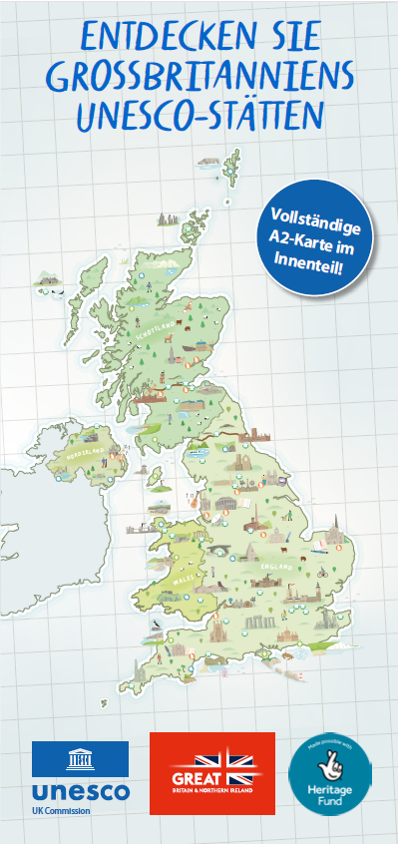
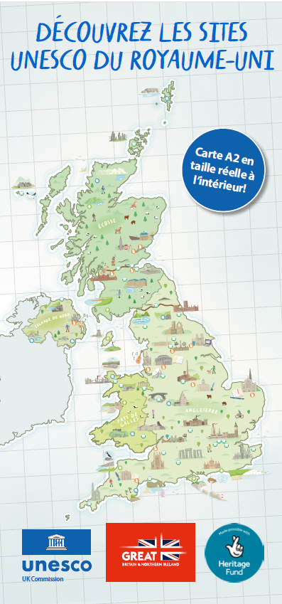
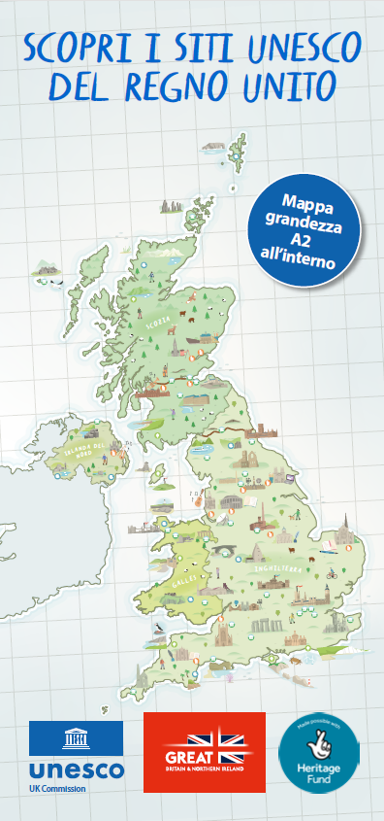
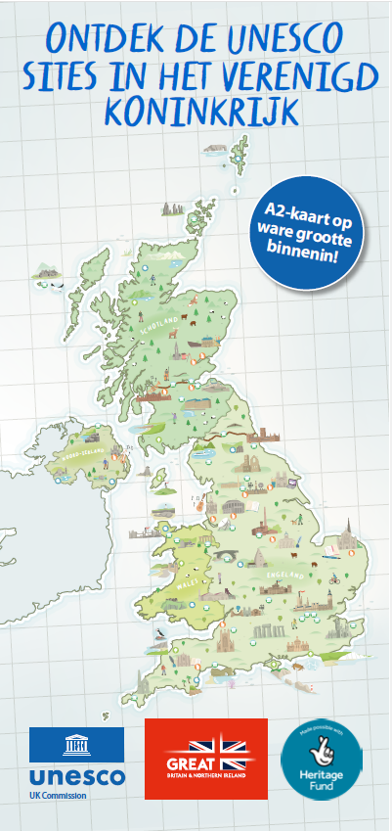
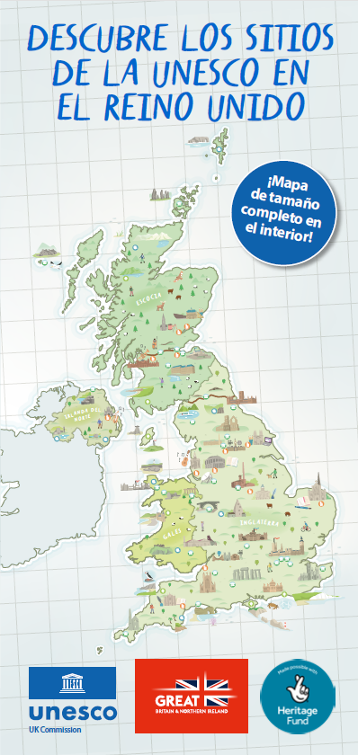
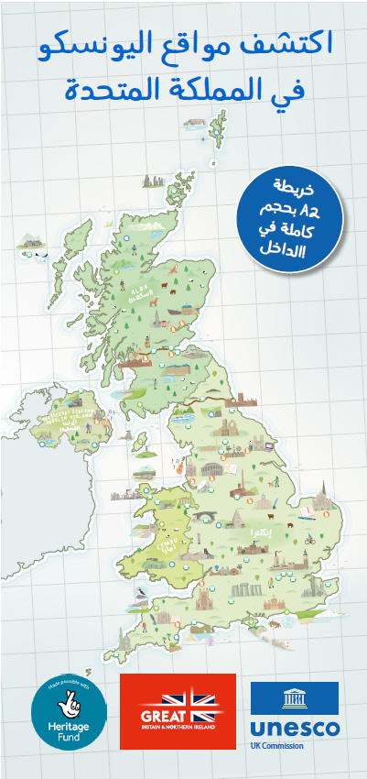
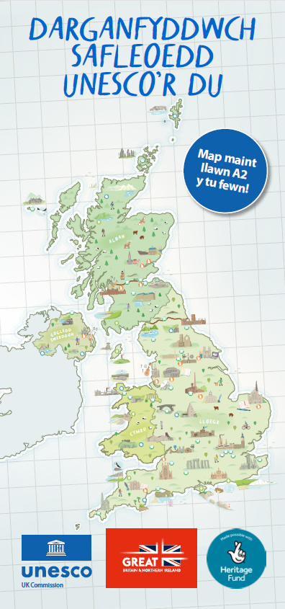
Find out more:
https://unesco.org.uk/our-sites

Slide 14
‘Local to Global’
Liam Smyth, Project Implementation Manager
lsmyth@unesco.org.uk
Notes:
Local to Global is about viewing place-based UNESCO designations as sites of sustainable development that deliver economic, social, educational, natural and cultural value.
As we move forward, we would like to explore partnerships with other national commissions to realise opportunities for multi level, cross designation international exchange between UNESCO sites. That is why we are currently working with our funders in the UK to grow the Local to Global project.
We know there are huge harvests of knowledge and wisdom in the world that will enable the collective action required to further the values of UNESCO. If you are interested in getting involved we would love to hear about the great work you are doing so please get in touch.

